Slide 1
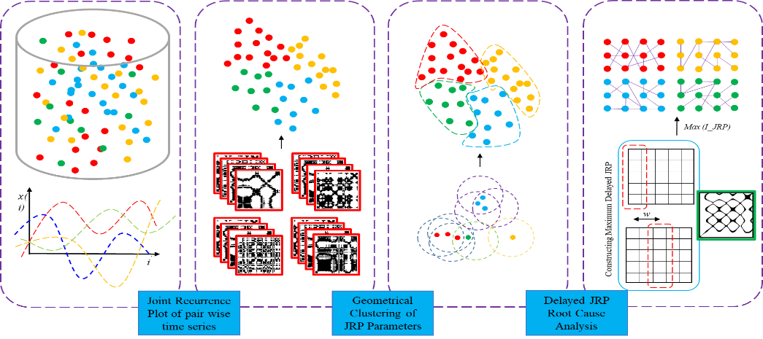
Fault Diagnosis of Chemical Processes based on Joint Recurrence Quantification Analysis
School of Chemical Engineering, College of Engineering, University of Tehran
Movie load here
Hooman Ziaei
3_{Minutes}

